Slide 1
HPCC++: Enhanced High Precision Congestion Control
draft-miao-iccrg-hpccplus-00
Rui Miao, Hongqiang Harry Liu, Rong Pan, Jeongkeun Lee, Changhoon Kim, Barak Gafni, Yuval Shpigelman
IETF-112 rtgwg
Nov 2021

Slide 2

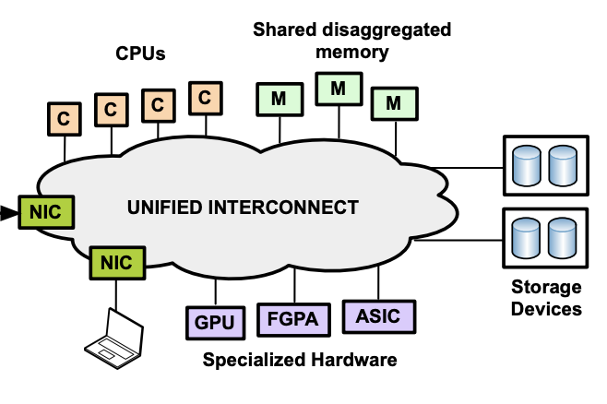
Cloud desires hyper-speed networking
bigger data to compute & store
Today, clouds have
faster compute & storage devices
more types of compute and storage resources
High-performance storage
High-performance computation
Resource disaggregation
Storage-compute separation is norm
HDD→SSD→NVMe
Higher-throughput, lower latency
1M IOPS / 50~100us
Distributed deep learning, HPC
CPU→GPU, FPGA, ASIC
Faster compute, lower latency
E.g. latency <10us
More network load
Need ultra-lower latency: 3-5us, > 40Gbps (Gao Et.al. OSDI’16)
Notes:
[title], because the network -> the performance bottleneck in many systems in the cloud
New applications such as high-perf storage and large-scale distributed deep-learning, use new hardware that can generate and process data orders of magnitude faster than before, and allow very low access latency, so network is much more important than before.
Moreover, resource disaggregation is happening in the cloud, which disaggregate compute and memory into separate pools. So even memory accesses will go through the network, which adds considerable load to the network, and requires ultra-low latency. As a result, network is becoming bottleneck.
[]
Title of high per compute

Slide 3
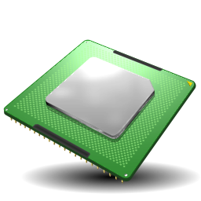


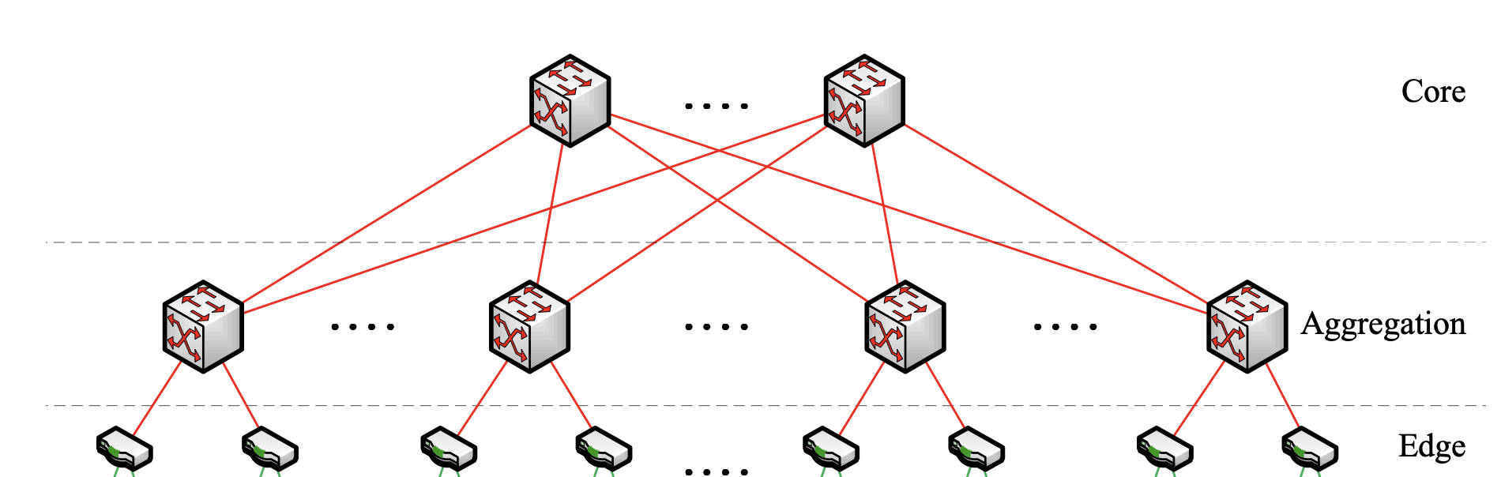
Hyper-speed network chips != hyper-speed networking
App
App
Hardware-offloading (e.g., RDMA)
Traditional software-based networking stacks cannot keep with the speed
Network Stack
Network Stack
Host
Host
Network Fabric
Congestion control (CC)
Since, end hosts are aggressive, network is more vulnerable to congestion & packet loss

Slide 4
Realistic challenges in CC in high-speed networks
Challenges in current CC
Operation challenge-1: PFC storm & deadlock
Running lossy networks is desired, but there is a convergence challenge!!!
Operation challenge-2: running multiple applications
QoS queues are scarce resources!!!
Operation challenge-3: complex parameter tuning
DCQCN has at least 15 parameters to tune!!!
Challenge-1:
Slow Convergence
Challenge-2: Standing queue
Challenge-3:
Heuristics in CC
Notes:
…
Keep a standing queue to maintain high throughput, but inflate latency. So in a mixed env, cannot meet the requirements for both high-through app and latency-sensitive app.
…
List the 3 problem here: slow convergence cannot solve loss, standing queue, and complex parameter tuning
Talk: more detais on them.

Slide 5

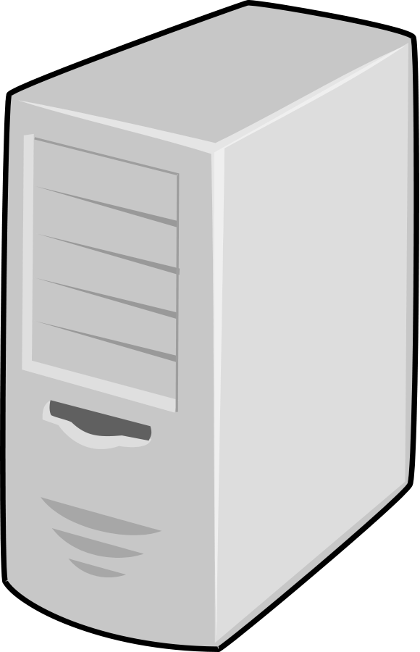
In-band telemetry
Packet loss?
Routing blackhole?
Latency spike?
Heavy hitter?
…
New commodity ASICs have in-band telemetry ability
Mainly used for trouble-shooting purposes
Collector
pkt
pkt
pkt
Telemetry
Telemetry
Sender
Receiver
Notes:
One or two slide to talk about INT
HPCC is an algorithem and is not that tight to INT format.
A set of meta data. The actual format is not important but we can show some examples.
It is import to that environment.

Slide 6

HPCC++: Enhanced High Precision Congestion Control
Can we use in-band telemetry as precise feedback for congestion control?
pkt
pkt
pkt
Telemetry
Telemetry
Adjust rate
per ACK
Sender
Receiver
Notification pkts/ACKs

Slide 7
In-band telemetry format
HPCC++ defines the algorithm of using telemetry information
including queue length, transmitted bytes, timestamp, link capacity, etc.
Yet, the actual packet format is up to the environment
bits | 31-24 |  | 23-16 | 15-8 | 7-0
0 | Device-ID |  |  |  |  | PT
1 | TID | congestion | Tx Bytes Cnt[39:32] | TTL | Queue ID
2 | Rx Timestamp Sec - Upper
3 | Rx Timestamp Sec |  |  | Rx Timestamp Nano Upper
4 | Rx Timestamp Nano |  |  | Tx Timestamp Nano Upper
5 | Tx Timestamp Nano |  |  | Egress Queue Cell Cnt
6 | Src-Sys-Port |  |  | Dest-Sys-port
7 | Tx Bytes Cnt[31:0]
Example format of in-band telemetry used by HPCC++

Slide 8
HPCC++ solves all there problems
Using in-band telemetry as the precise feedback
Fast convergence
Sender knows the precise rate to adjust to, on every ACK
Near-zero queue
Feedback does not only rely on queue
Few parameters
Precise feedback, so no need for heuristics which requires many parameters
Notes:
All 3 actually share same [read]
CC converges slowly [read]
There are standing queues [read]
Parameter tuning is complex [read]
So we ask, [read]
It turns out, just the right time to ask this question
10:20
[] feedback should not rely on queue

Slide 9
Smart routing with HPCC++
Route condition changes drastically in DC
e.g, incast, failure, re-routing, …
HPCC++ offers a precise “view” of a route’s capacity
Joint decision on routing and traffic allocation by combining views of routes
Host1
pkt
Route 1
pkt
pkt
Host3
Host2
Route 2
failure
Notification pkts/ACKs

Slide 10
In-band telemetry vs ECN
ECN = Explicit Congestion Notification, single-bit notification
Inband telemetry provides fine-grained network load information
e.g., queue length, transmitted bytes, timestamp, link capacity, etc.
Quickly converge to proper rate to highly utilize bandwidth while avoiding congestion
Consistently maintain a close-to-zero queue for low latency
Overhead of in-band telemetry (5-hop switches in DC paths)
Per-packet telemetry (w/ compact): up to 42B or 4.2% in a 1KB packet
Per-RTT probing packet (w/ IFA1.0): up to 200B or 2.5% for each 8KB data
In DC, bandwidth is generally abundant, but the latency is much more important

Slide 11
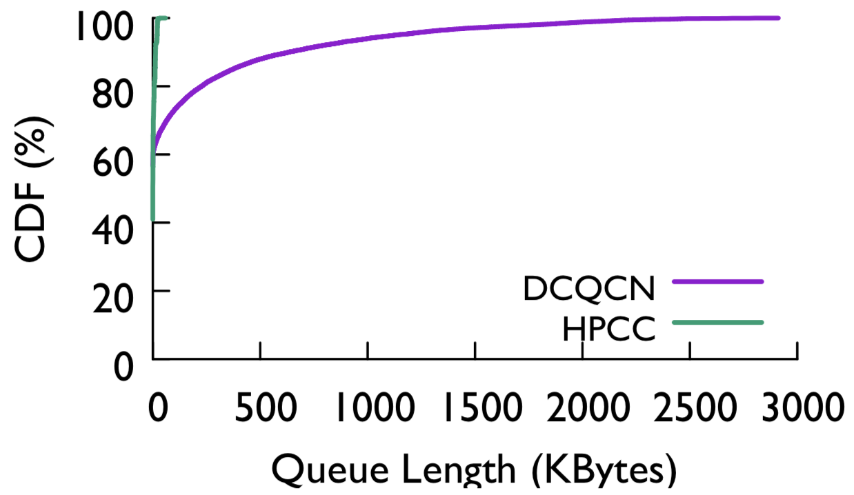
HPCC++ achieves lower FCT and near-zero queue
In testbed, vs. DCQCN (hardware-based, widely used in industry)
Web search traffic at 50% load
Vs. other CC (unavailable in HW) in simulation. HPCC performs better
HPCC++
- P99: 23KB (7us queue delay)
95% lower
55% lower
Notes:
In our testbed, we show that HPCC reduces the flow completion time a lot. We compare with DCQCN, which is a hardware-based solution that is widely used in industry, and also widely deployed in Alibaba. HPCC performs better under many diff traffic patterns. For example, with web search traffic at 50% load, HPCC significantly reduces the tail FCT. Note that for long flows, HPCC and DCQCN performs similar; this is because they are less sensitive to queueing delay, and they occupy the bandwidth most of the time.
We also monitor the queue length distribution. HPCC achieves near zero queue. Even at 99pct, the queue length is only 23KB, which is only 7us queueing delay.
We also compare with other CC. They are not available in HW, so we compare in simulation. The result is similar. Refer to paper.
24:48

Slide 12
Thank You

